Slide 1
Concept learning
  Machine Learning, Tom Mitchell
  Mc Graw-Hill International Editions, 1997
  (Cap 1, 2).

Slide 2
Introduction to machine learning
Introduction to machine learning
  When appropriate and when not appropriate
  Task definition
  Learning methodology: design, experiment, evaluation
  Learning issues: representing hypothesis
  Learning paradigms
    Supervised learning
    Unsupervised learning
    Reinforcement learning
Next week …

Slide 3
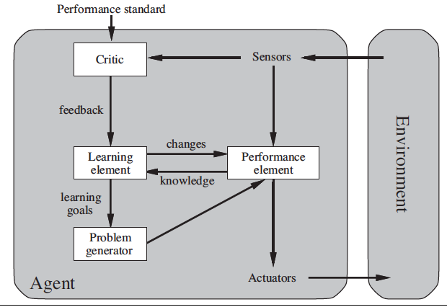
AIMA learning architecture

Slide 4
Machine learning: definition
A computer program is said to learn from experience E with respect to some class of tasks T and performance measure P, if its performance at tasks in T, as measured by P, improves with experience E [Mitchell]
Problem definition for a learning agent
  Task T
  Performance measure P
  Experience E

Slide 5
Designing a learning system
Choosing the training experience
  Examples of best moves, games outcome …
Choosing the target function
  board-move, board-value, …
Choosing a representation for the target function
  linear function with weights (hypothesis space)
Choosing a learning algorithm for approximating the target function
  A method for parameter estimation

Slide 6
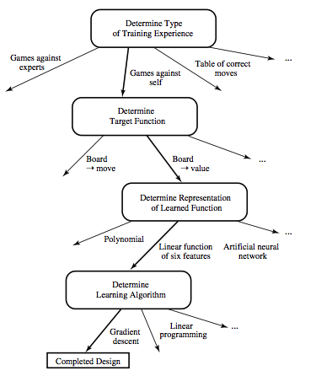
Design of a learning system
Mitchell
Notes:
In che forma è disponibile l' esperienza? Quanti dati di apprendimento servono? Ed eventualmente possiamo suggerire quali dati darebbero utili per apprendere meglio?
Che cosa si deve apprendere? Una funzione di valutazione della scacchiera che guida in un processo di ricerca euristica, una funzione booleana, una funzione continua.
Come rappresentare la funzione da apprendere? La rappresentazione `e strettamente collegata all' insieme delle ipotesi che si possono candidare come risultato del processo. Un programma non può appredenre ciò che non è in grado di rappresentare.
Quali modelli e algoritmi sono più appropriati per il particolare problema? Che proprietà hanno?

Slide 7
Inductive learning
Inductive learning
  Inducing a general function from training examples
  A supervised paradigm
Basic schemas that assume a logical representation of the hypothesis
  Concept learning
  Decision trees learning
  Important issues
    Inductive bias (definition)
    The problem of overfitting
Bibliography:
  Mitchell, cap1,2,3
Notes:
Apprendimento induttivo, una forma di apprendimento supervisionato.

Slide 8
Definition of concept learning
Task: learning a category description (concept) from a set of positive and negative training examples.
  Concept may be an event, an object …
Target function: a boolean function c: X → {0, 1}
Experience: a set of training instances D:{⟨x, c(x)⟩}
A search problem for best fitting hypothesis in a hypotheses space
  The space is determined by the choice of representation of the hypothesis (all boolean functions or a subset)

Slide 9
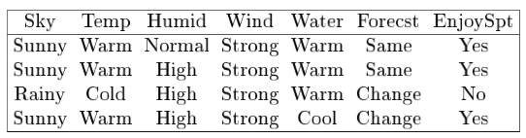
Sport example
Concept to be learned:
  Days in which Aldo can enjoy water sport
  Attributes:
  Sky: Sunny, Cloudy, Rainy Wind: Strong, Weak
  AirTemp: Warm, Cold Water: Warm, Cool
  Humidity: Normal, High Forecast: Same, Change
Instances in the training set (out of the 96 possible):
Notes:
Le instanze possibili sono 3x2x2x2x2x2 = 3 x 32 = 96

Slide 10
Hypotheses representation
h is a set of constraints on attributes:
  a specific value: e.g. Water = Warm
  any value allowed: e.g. Water = ?
  no value allowed: e.g. Water = Ø
Example hypothesis:
Sky AirTemp Humidity Wind Water Forecast
  ⟨Sunny, ?, ?, Strong, ?, Same⟩
  Corresponding to boolean function:
  Sunny(Sky) ∧ Strong(Wind) ∧ Same(Forecast)
H, hypotheses space, all possible h

Slide 11
Hypothesis satisfaction
An instance x satisfies an hypothesis h iff all the constraints expressed by h are satisfied by the attribute values in x.
Example 1:
x₁: ⟨Sunny, Warm, Normal, Strong, Warm, Same⟩
h₁: ⟨Sunny, ?, ?, Strong, ?, Same⟩ Satisfies? Yes
Example 2:
x₂: ⟨Sunny, Warm, Normal, Strong, Warm, Same⟩
h₂: ⟨Sunny, ?, ?, Ø, ?, Same⟩ Satisfies? No

Slide 12
Formal task description
Given:
  X all possible days, as described by the attributes
  A set of hypothesis H, a conjunction of constraints on the attributes, representing a function h: X → {0, 1}
  [h(x) = 1 if x satisfies h; h(x) = 0 if x does not satisfy h]
  A target concept: c: X → {0, 1} where
  c(x) = 1 iff EnjoySport = Yes;
  c(x) = 0 iff EnjoySport = No;
  A training set of possible instances D: {⟨x, c(x)⟩}
Goal: find a hypothesis h in H such that
  h(x) = c(x) for all x in D
  Hopefully h will be able to predict outside D…

Slide 13
The inductive learning assumption
We can at best guarantee that the output hypothesis fits the target concept over the training data
Assumption: an hypothesis that approximates well the training data will also approximate the target function over unobserved examples
i.e. given a significant training set, the output hypothesis is able to make predictions

Slide 14
Concept learning as search
Concept learning is a task of searching an hypotheses space
The representation chosen for hypotheses determines the search space
In the example we have:
  3 x 2⁵ = 96 possible instances (6 attributes)
  1 + 4 x 3⁵= 973 possible hypothesis
  considering that all the hypothesis with some ∅ are semantically equivalent, i.e. inconsistent
Structuring the search space may help in searching more efficiently
Notes:
|H| sono tutte le possibile ennuple senza il valore 0 (escludiamo ennuple che non sono mai soddisfatte) più la ennupla con tutti 0

Slide 15
General to specific ordering
Consider:
  h₁ = ⟨Sunny, ?, ?, Strong, ?, ?⟩
h₂ = ⟨Sunny, ?, ?, ?, ?, ?⟩
Any instance classified positive by h₁ will also be classified positive by h₂
h₂ is more general than h₁
Definition: h_{j} ≥_{g} h_{k} iff (∀x ∈ X ) [(h_{k} = 1) → (h_{j} = 1)]
≥_{g} more general or equal; >_{g} strictly more general
Most general hypothesis: ⟨?, ?, ?, ?, ?, ?⟩
Most specific hypothesis: ⟨Ø, Ø, Ø, Ø, Ø, Ø⟩

Slide 16
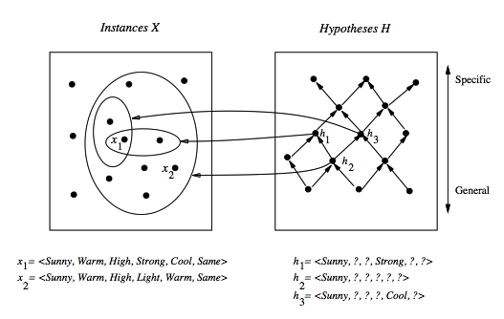
General to specific ordering: induced structure
Notes:
Partial order: reflexive, anti--symmetric, transitive.

Slide 17
Find-S: finding the most specific hypothesis
Exploiting the structure we have alternatives to enumeration …
Initialize h to the most specific hypothesis in H
For each positive training instance:
  for each attribute constraint a in h:
  If the constraint a is satisfied by x then do nothing
  else replace a in h by the next more general constraint
  satified by x (move towards a more general hp)
Output hypothesis h

Slide 18
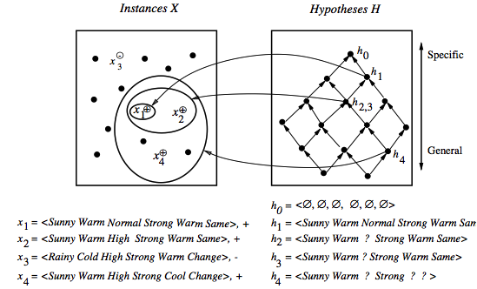
Find-S in action

Slide 19
Properties of Find-S
Find-S is guaranteed to output the most specific hypothesis within H that is consistent with the positive training examples
The final hypothesis will also be consistent with the negative examples
Problems:
  There can be more than one “most specific hypotheses”
  We cannot say if the learner converged to the correct target
  Why choose the most specific?
  If the training examples are inconsistent, the algorithm can be mislead: no tolerance to rumor.
  Negative example are not considered

Slide 20
Candidate elimination algorithm: the idea
The idea: output a description of the set of all hypotheses consistent with the training examples (correctly classify training examples).
Version space: a representation of the set of hypotheses which are consistent with D
  an explicit list of hypotheses (List-Than-Eliminate)
  a compact representation of hypotheses which exploits the more_general_than partial ordering (Candidate-Elimination)

Slide 21
Version space
The version space VS_{H,D} is the subset of the hypothesis from H consistent with the training example in D
VS_{H,D} ≡{h ∈ H | Consistent(h, D)}
An hypothesis h is consistent with a set of training examples D iff h(x) = c(x) for each example in D
Consistent(h, D) ≡ (∀ ⟨x, c(x)⟩ ∈ D) h(x) = c(x))
Note: "x satisfies h" (h(x)=1) different from “h consistent with x"
In particular when an hypothesis h is consistent with a negative example d =⟨x, c(x)=No⟩, then x must not satisfy h
Notes:
Consistente significa essere in accordo con la funzione target (un ipotesi è consistente ocn un esempio di apprendimento quando h(x) = c(x)
Un esempio soddisfa una ipotesi quando è un esempio positivo secondo l’ ipotesi (h(x) = 1).

Slide 22
The List-Then-Eliminate algorithm
Version space as list of hypotheses
VersionSpace ← a list containing every hypothesis in H
For each training example, ⟨x, c(x)⟩
Remove from VersionSpace any hypothesis h for which h(x) ≠ c(x)
Output the list of hypotheses in VersionSpace
Problems
  The hypothesis space must be finite
  Enumeration of all the hypothesis, rather inefficient

Slide 23
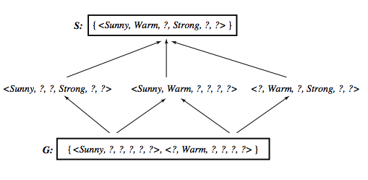
A compact representation for Version Space
Note: The output of Find-S is just ⟨Sunny, Warm, ?, Strong, ?, ?⟩
Version space represented by its most general members G and its most specific members S (boundaries)

Slide 24
General and specific boundaries
The Specific boundary, S, of version space VS_{H,D} is the set of its minimally general (most specific) members
S ≡{s ∈ H | Consistent(s, D)∧(¬∃s' ∈ H)[(s >_{g}s') ∧ Consistent(s', D)]}
Note: any member of S is satisfied by all positive examples, but more specific hypotheses fail to capture some
The General boundary, G, of version space VS_{H,D} is the set of its maximally general members
G ≡{g ∈ H | Consistent(g, D)∧(¬∃g' ∈ H)[(g' >_{g} g) ∧ Consistent(g', D)]}
Note: any member of G is satisfied by no negative example but more general hypothesis cover some negative example
Notes:
In S troviamo le ipotesi più specifiche che coprono tutti gli esempi positivi; se specializzassimo ulteriormente qualche esempi positivo non sarebbe coperto.
In G troviamo il massimo della generalizzazione possibile che non copre alcun esempio negativo.

Slide 25
Version Space representation theorem
G and S completely define the Version Space
Theorem: Every member of the version space (h consistent with D) is in S or G or lies between these boundaries
VS_{H,D}={h ∈ H |(∃s ∈ S) (∃g ∈ G) (g ≥_{g} h ≥_{g} s)}
where x ≥_{g} y means x is more general or equal to y
Sketch of proof:
⇐ If g ≥_{g} h ≥_{g} s, since s is in S and h ≥_{g} s, h is satisfied by all positive examples in D; g is in G and g ≥_{g} h, then h is satisfied by no negative examples in D; therefore h belongs to VS_{H,D}
⇒ It can be proved by assuming a consistent h that does not satisfy the right-hand side and by showing that this would lead to a contradiction
Notes:
Supponiamo che h sia consistente con tutti gli esempi in D (+ e -) ma non sia g >= h >= s, con s in S e g in G.
h dovrebbe cadere al di fuori del reticolo e quindi essere
più specifico di qualche s in S, contro l’ ipotesi che non si possano restringere ulteriormente le ipotesi senza escludere qualche esempio positivo
più generale di qualche ipotesi in g, contro l’ ipotesi che non si possano generalizzare ipotesi senza coprire qualche esempio negativo.
o più generale qualche g in G

Slide 26
Candidate elimination algorithm-1
S ← minimally general hypotheses in H,
G ← maximally general hypotheses in H
Initially any hypothesis is still possible
S₀ = ⟨∅, ∅, ∅, ∅, ∅, ∅⟩ G₀ = ⟨?, ?, ?, ?, ?, ?⟩
For each training example d, do:
If d is a positive example:
Remove from G any h inconsistent with d
Generalize(S, d)
If d is a negative example:
Remove from S any h inconsistent with d
Specialize(G, d)
Note: when d =⟨x, No⟩ is a negative example, an hypothesis h is inconsistent with d iff h satisfies x

Slide 27
Candidate elimination algorithm-2
Generalize(S, d): d is positive
  For each hypothesis s in S not consistent with d:
  Remove s from S
  Add to S all minimal generalizations of s consistent with d and having a generalization in G
  Remove from S any hypothesis with a more specific h in S
Specialize(G, d): d is negative
  For each hypothesis g in G not consistent with d: i.e. g satisfies d,
  Remove g from G but d is negative
  Add to G all minimal specializations of g consistent with d and having a specialization in S
  Remove from G any hypothesis having a more general hypothesis in G

Slide 28
Example: initially
S₀:
⟨∅, ∅, ∅, ∅, ∅. ∅⟩
G₀
⟨?, ?, ?, ?, ?, ?⟩

Slide 29
Example: after seing ⟨Sunny,Warm, Normal, Strong, Warm, Same ⟩ +
S₀:
⟨∅, ∅, ∅, ∅, ∅. ∅⟩
S₁:
⟨Sunny,Warm, Normal, Strong, Warm, Same⟩
G₀, G₁
⟨?, ?, ?, ?, ?, ?⟩

Slide 30
Example: after seing ⟨Sunny,Warm, High, Strong, Warm, Same⟩ +
S₁:
⟨Sunny,Warm, Normal, Strong, Warm, Same⟩
S₂:
⟨Sunny,Warm, ?, Strong, Warm, Same⟩
G₁, G₂
⟨?, ?, ?, ?, ?, ?⟩

Slide 31
Example: after seing ⟨Rainy, Cold, High, Strong, Warm, Change ⟩−
S_{2,} S₃:
⟨Sunny, Warm, ?, Strong, Warm, Same⟩
G₃:
⟨Sunny, ?, ?, ?, ?, ?⟩ ⟨?, Warm, ?, ?, ?, ?⟩ ⟨?, ?, ?, ?, ?, Same⟩
G₂:
⟨?, ?, ?, ?, ?, ?⟩

Slide 32
Example: after seing ⟨Sunny, Warm, High, Strong, Cool Change ⟩ +
S₃
⟨Sunny, Warm, ?, Strong, Warm, Same⟩
S₄
⟨Sunny, Warm, ?, Strong, ?, ?⟩
G₄:
⟨Sunny, ?, ?, ?, ?, ?⟩ ⟨?, Warm, ?, ?, ?, ?⟩
G₃:
⟨Sunny, ?, ?, ?, ?, ?⟩ ⟨?, Warm, ?, ?, ?, ?⟩ ⟨?, ?, ?, ?, ?, Same⟩

Slide 33
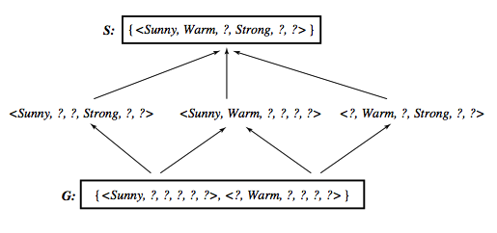
Learned Version Space

Slide 34
Observations
The learned Version Space correctly describes the target concept, provided:
  There are no errors in the training examples
  There is some hypothesis that correctly describes the target concept
If S and G converge to a single hypothesis the concept is exactly learned
In case of errors in the training, useful hypothesis are discarded, no recovery possible
An empty version space means no hypothesis in H is consistent with training examples

Slide 35
Ordering on training examples
The learned version space does not change with different orderings of training examples
Efficiency does
Optimal strategy (if you are allowed to choose)
  Generate instances that satisfy half the hypotheses in the current version space. For example:
  ⟨Sunny, Warm, Normal, Light, Warm, Same⟩ satisfies 3/6 hyp.
  Ideally the VS can be reduced by half at each experiment
  Correct target found in ⎡log₂|VS|⎤ experiments

Slide 36
Use of partially learned concepts
Classified as positive by all hypothesis, since satisfies any hypothesis in S

Slide 37
Classifying new examples
Classified as negative by all hypothesis, since does not satisfy any hypothesis in G

Slide 38
Classifying new examples
Uncertain classification: half hypothesis are consistent, half are not consistent

Slide 39
Classifying new examples
⟨Sunny, Cold, Normal, Strong, Warm, Same⟩
4 hypothesis not satisfied; 2 satisfied
Probably a negative instance. Majority vote?

Slide 40
Hypothesis space and bias
What if H does not contain the target concept?
Can we improve the situation by extending the hypothesis space?
Will this influence the ability to generalize?
These are general questions for inductive inference, addressed in the context of Candidate-Elimination
Suppose we include in H every possible hypothesis … including the ability to represent disjunctive concepts

Slide 41
Extending the hypothesis space
 | Sky | AirTemp | Humidity | Wind | Water | Forecast | EnjoyS
1 | Sunny | Warm | Normal | Strong | Cool | Change | YES
2 | Cloudy | Warm | Normal | Strong | Cool | Change | YES
3 | Rainy | Warm | Normal | Strong | Cool | Change | NO
No hypothesis consistent with the three examples with the assumption that the target is a conjunction of constraints
⟨?, Warm, Normal, Strong, Cool, Change⟩ is too general
Target concept exists in a different space H', including disjunction and in particular the hypothesis
  Sky=Sunny or Sky=Cloudy

Slide 42
An unbiased learner
Every possible subset of X is a possible target
|H'| = 2^{|X|}, or 2⁹⁶ (vs |H| = 973, a strong bias)
This amounts to allowing conjunction, disjunction and negation
⟨Sunny, ?, ?, ?, ?, ?⟩ V <Cloudy, ?, ?, ?, ?, ?⟩
Sunny(Sky) V Cloudy(Sky)
We are guaranteed that the target concept exists
No generalization is however possible!!!
Let's see why …

Slide 43
No generalization without bias!
VS after presenting three positive instances x₁, x₂, x₃, and two negative instances x₄, x₅
  S = {(x₁ v x₂ v x₃)}
  G = {¬(x₄ v x₅)}
  … all subsets including x₁ x₂ x₃ and not including x₄ x₅
We can only classify precisely examples already seen!
Take a majority vote?
  Unseen instances, e.g. x, are classified positive (and negative) by half of the hypothesis
  For any hypothesis h that classifies x as positive, there is a complementary hypothesis ¬h that classifies x as negative

Slide 44
No inductive inference without a bias
A learner that makes no a priori assumptions regarding the identity of the target concept, has no rational basis for classifying unseen instances
The inductive bias of a learner are the assumptions that justify its inductive conclusions or the policy adopted for generalization
Different learners can be characterized by their bias
See next for a more formal definition of inductive bias …

Slide 45
Inductive bias: definition
Given:
  a concept learning algorithm L for a set of instances X
  a concept c defined over X
  a set of training examples for c: D_{c} = {⟨x, c(x)⟩}
  L(x_{i}, D_{c}) outcome of classification of x_{i} after learning
Inductive inference ( ≻ ):
D_{c} ∧ x_{i} ≻ L(x_{i}, D_{c})
The inductive bias is defined as a minimal set of assumptions B, such that (|− for deduction)
∀ (x_{i} ∈ X) [ (B ∧ D_{c} ∧ x_{i}) |− L(x_{i}, D_{c}) ]

Slide 46
Inductive bias of Candidate-Elimination
Assume L is defined as follows:
  compute VS_{H,D}
  classify new instance by complete agreement of all the hypotheses in VS_{H,D}
Then the inductive bias of Candidate-Elimination is simply
B ≡ (c ∈ H)
In fact by assuming c ∈ H:
  c ∈ VS_{H,D} , in fact VS_{H,D} includes all hypotheses in H consistent with D
  L(x_{i}, D_{c}) outputs a classification "by complete agreement", hence any hypothesis, including c, outputs L(x_{i}, D_{c})

Slide 47
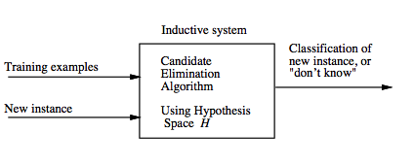
Inductive system

Slide 48
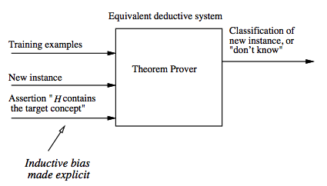
Equivalent deductive system

Slide 49
Each learner has an inductive bias
Three learner with three different inductive bias:
  Rote learner: no inductive bias, just stores examples and is able to classify only previously observed examples
  CandidateElimination: the concept is a conjunction of constraints.
  Find-S: the concept is in H (a conjunction of constraints) plus "all instances are negative unless seen as positive examples” (stronger bias)
  The stronger the bias, greater the ability to generalize and classify new instances (greater inductive leaps).

Slide 50
Bibliography
Machine Learning, Tom Mitchell, Mc Graw-Hill International Editions, 1997 (Cap 2).

